Slide 1




DATA BASE
Digitalizing the Ethio-MicroLend organization
Presented by Group 7

Slide 2
Group Name
ID_num
Hammere Shimelse ETS0687/17
2. Hanan Fedlu ETS 0696/17
3. Helen Tesfaye ETS 0721/17
4. Ineb Hussen ETS 0765/17
5. Ivana Yared ETS 0771/17
6. Jije Israel ETS 0775/17

Slide 3
Background of the organization
Founded to support underserved communities lacking access to traditional banking services
Focuses on low income individuals, small businesses, and rural families
Provides micro loans, savings services, and financial literacy education
Enables clients to invest in agriculture, education, and small enterprises
Expanded to serve farmers, women entrepreneurs, youth groups, and informal workers
Faces challenges due to manual paperwork and fragmented systems causing delays and inefficiency
Introducing a digital loan management system using MySQL and MongoDB to improve efficiency, transparency, and data management

Slide 4
Statement of problem
Relies on manual, paper based processes for loan and savings management
Disorganized record keeping leads to duplication, errors, and delays
Clients experience long waiting times for loan approvals
Difficulty tracking repayment schedules and identifying overdue loans
Increased risk of loan defaults affecting financial stability
Challenges in generating accurate reports for decision making and compliance
System is not scalable, making it hard to manage growing client data and operations

Slide 5
Objectives
General Objective
Develop a centralized digital database system to improve efficiency, accuracy, transparency, and scalability in loan and savings management.
Specific Objectives
Digitize Client Records – Store all client data in one system
Integrate Loan & Savings Data – Link financial records
Automate Loan Processing – Simplify approvals and scheduling
Enhance Repayment Monitoring – Track and alert overdue payments
Generate Reports – Provide automated financial insights
Support Scalability – Handle growing data efficiently
Use MySQL & MongoDB – Manage structured & unstructured data
Improve Transparency – Ensure accurate, accessible information

Slide 6
Scope and Benefits
Scope
Covers client registration, loans, repayments, and savings
Supports individual and group lending
Centralized database for all financial transactions
Combines structured (MySQL) and unstructured data (MongoDB)
Benefits
Reduces errors and delays from manual processes
Faster and more efficient service for clients and staff
Improves transparency and accountability
Automated alerts help reduce loan defaults
Scalable system for future growth
Supports better decision making and compliance

Slide 7
Methodology and Tools
Methodology
Analyze current system and define problems & objectives
Follow phases: design → implementation → testing
Design ER diagram (Clients, Loans, Repayments, Savings, Officers)
Normalize database to BCNF for accuracy and efficiency
Test system with sample data and refine
Tools
MySQL – Structured data (clients, loans, repayments, savings)
MongoDB – Unstructured data (documents, feedback, materials)
Google Docs – Documentation
GitHub – Version control
Telegram – Team communication

Slide 8
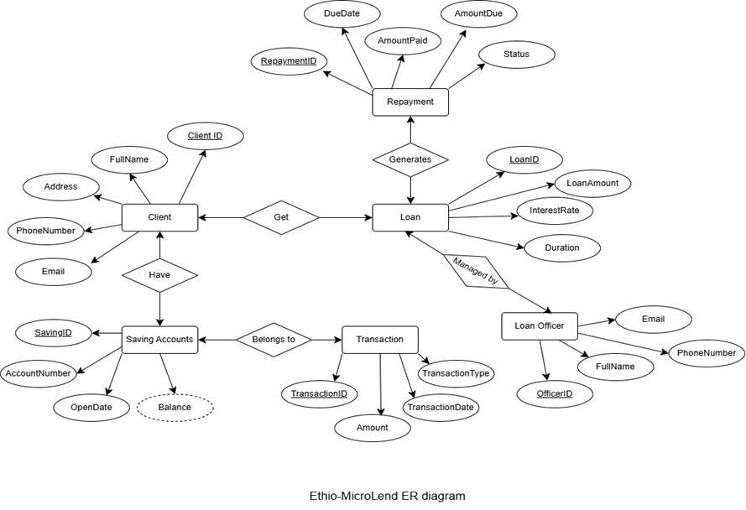
Entities:
Client: (borrowers, savers)
Loan: (loan details: amount, type, duration, interest rate)
Repayment: (installments, due dates, payment status)
Savings Account: (balance, deposits, withdrawals)
Loan Officer: (staff managing loans)
Transaction: (records of deposits, withdrawals, repayments)
Relationships:
A Client can have multiple Loans.
A Loan is managed by one Loan Officer.
A Loan generates multiple Repayments.
A Client can have one or more Savings Accounts.
A Transaction belongs to either a Loan Repayment or a Savings Account.
Entities & Relationship
ER Diagram

Slide 9
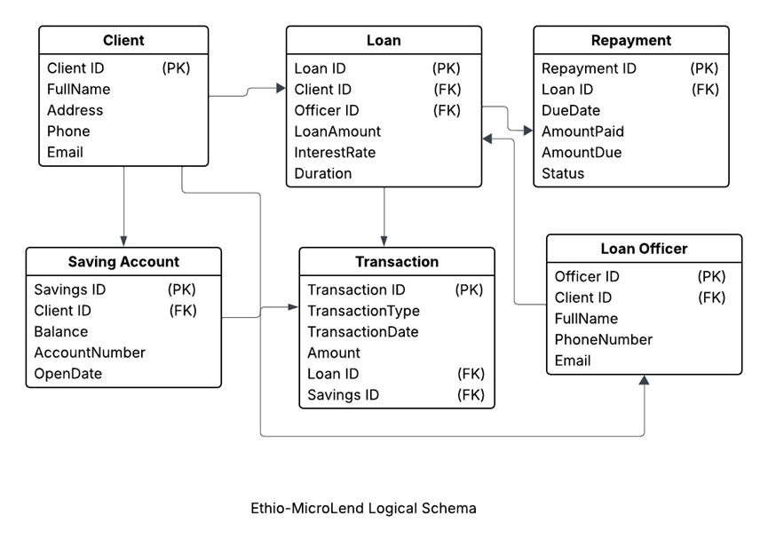
Logical Schema

Slide 10
Normalization Up To BCNF
1NF – All attributes are atomic (no repeating or multi valued fields)
2NF – No partial dependency (single primary keys used)
3NF – No transitive dependency; fixed Loan Officer issue by removing ClientID
BCNF – All functional dependencies use superkeys (no violations)
Final Schema
Client (ClientID, FullName, Address, Phone, Email)
Loan (LoanID, ClientID, OfficerID, LoanAmount, InterestRate, Duration)
Repayment (RepaymentID, LoanID, DueDate, AmountPaid, AmountDue, Status)
SavingAccount (SavingsID, ClientID, Balance, AccountNumber, OpenDate)
Transaction (TransactionID, Type, Date, Amount, LoanID, SavingsID)
LoanOfficer (OfficerID, FullName, Phone, Email)

Slide 11
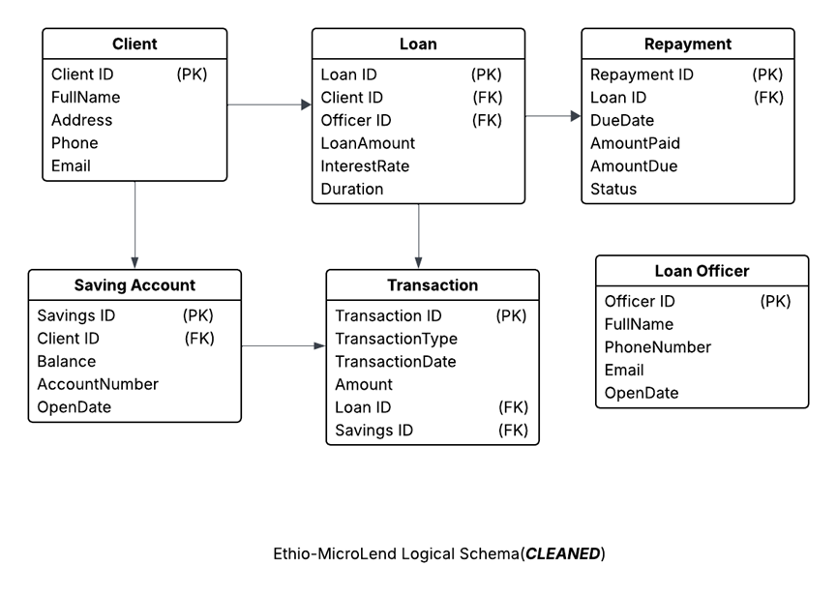
Logical Schema (cleared)

Slide 12
Inputs, Outputs and Reports
Inputs (Forms):
Client Registration – Add new client details
Loan Application – Record loan requests & assign officer
Repayment Form – Track loan payments and status
Savings Account Form – Manage client savings accounts
Transaction Form – Record deposits, withdrawals, loans
Loan Officer Form – Manage staff information
Outputs:
Client Profile – Client details overview
Loan Status – Loan info (amount, interest, duration)
Repayment Summary – Payment history and status
Savings Account – Balance and account details
Transaction History – Filtered transaction records
Officer Assignment – Assigned loan officer per loan

Slide 13
Inputs, Outputs and Reports
Reports:
Client Report – Client details list
Loan Portfolio – Summary of all loans
Repayment Report – Overdue loans & repayment rates
Savings Report – Account balances and activity
Transaction Report – Detailed transaction records
Officer Performance – Loans handled & performance metrics

Slide 14
MySQL Implementation
Implementation:
The system is implemented using MySQL for structured data and MongoDB for unstructured data, enabling efficient management of financial records and documents.
MySQL Implementation (Tables):
Client (ClientID, FullName, Address, Phone, Email)
Loan (LoanID, ClientID, OfficerID, LoanAmount, InterestRate, Duration)
Repayment (RepaymentID, LoanID, DueDate, AmountPaid, AmountDue, Status)
SavingAccount (SavingsID, ClientID, Balance, AccountNumber, OpenDate)
Transaction (TransactionID, Type, Date, Amount, LoanID, SavingsID)
LoanOfficer (OfficerID, FullName, PhoneNumber, Email)

Slide 15
MongoDB Implementation:
Applications – Stores scanned loan application documents
Feedback – Stores client feedback and suggestions
Handles semi-structured and unstructured data
Testing:
Functional Testing – Verified forms capture correct data and outputs
Query Testing – Ensured accurate SQL results (loans, savings, repayments)
Integration Testing – Confirmed MySQL (structured) + MongoDB (unstructured) work together
Bug Tracking – Fixed issues in MongoDB document structure and MySQL database selection

Slide 16
Results and Improvements
Results:
Reduced loan approval time significantly
Automated repayment monitoring with alerts
Unified loan and savings data for better transparency
Improvements:
Add mobile app for client access
Enhance reporting with dashboard visualizations
Add MongoDB collection for training materials (financial literacy)
Implement role-based access control for security

Slide 17
Conclusion
Inputs (Forms) – Capture raw data into the system
Outputs – Provide instant information to users
Reports – Deliver summaries for management decision making
Together, they ensure efficiency, data integrity, and consistency
The system successfully digitized Ethio MicroLend operations
MySQL manages structured financial data efficiently
MongoDB handles flexible unstructured data
The combined system improves scalability, transparency, and efficiency, supporting financial inclusion

